Slide 1














SmartConnect Project Innovation in Integrated & Personalized Care for Cancer Patients: Digital Platform for Personalized and Integrated Services for Palliative Care, Symptom Management and Psychosocial Support
Prepared in collaboration with Partners Below
EU H2020 Call: SC1-DTH-11-2019

Slide 2
H2020 EU Commission’s Needs? Smart Connect Proposal
H2020
Health, Demographic Change and Wellness
Digital Innovation for Care
SC1-DTH-11-2019-Large Scale Pilots for Integrated and Personalized Care
EU Call requirements
SmartConnect Proposal
Large Scale Pilots for Integrated and Personalized
Care
Specific Areas
For Integrated Cancer Care
Areas
One Digital platform for professionals
& patients
Integrate hospitals, clinics, GPs & HHAs
Integrate communities & public health
Patient engagement tools (mobile)
Patient Care areas
Palliative Care
Symptom and Toxicity mgmt.
Psychosocial services
Measures
Ratio Professionals/Patients
% of Professionals integrated
Quality of life & clinical outcomes
Costs and utilization
Needs
Live Digital solutions on integrated care
Connecting professionals
Integrating GPs, community & hospitals
Quality of life measures
Outcomes monitoring
Cost of care measurement
Sustainability and scalability
Large scale Pilots (Scalability is key)

Slide 3
H2020 Call SC1-DTH-11-2019 : Large scale pilots of personalised & integrated care
Deadline: April 24th 2019. Innovation Action: EU contribution: 5-6 Million EUR – Expected Budget closer to 6 Million
Summary: Senior people are statistically at greater risk of cognitive impairment, frailty and multiple chronic health conditions with consequences for their independence, their quality of life (and the one of their families) but also for the sustainability of health and social care systems. There is also increasing evidence that interactions with the environment play an important role in the evolution of the patient's health status and condition. The challenge is now to foster secure, scalable and robust digital solutions for integrated care which will: Ensure a truly personalized delivery of health and social care, whilst supporting outcomes-based significant efficiency gains in health and care delivery.
H2020 Call Objectives:
To foster large-scale pilots for deployment of personalised and replicable digital solutions dealing with Integrated Care in multidisciplinary environment
Ensuring accuracy, reliability and security of data sharing at each step of data stream to increase recruitment of professionals and patients, whilst improving professionals' working conditions
Designing outcome-based reliable and sustainable business models
Quality of life should be measured on the basis of commonly used questionnaires (like SF36) but also if required on the basis of specific disease-oriented measurement tools.
Measurement of cost-efficiency should be measured on the basis of work time information dedicated to each patient. users trust with regard to health and social data and information in IT supported environment, in line with existing EU data protection regulation (and if required with EU reflection on platforms).
Harmonisation, certification, approval labelling or reliable identification of adequate solutions for integrated care. Robust and reliable and replicable business models for IT supported solutions in a truly personalized and multi-disciplinary environment.

Slide 4
Background and Opportunity on Integrated Cancer Care
Over 1 in 2 patients in Europe and UK do not have a well monitored and structured care transitions plan during and after treatment for Cancer patients
Often symptoms and psychosocial issues are just not tracked by providers due to lack of incentives to further engage general practitioners, specialists, community and public health with patients
Nearly 95% of the patients with psychosocial needs (such as support at home, nutritional issues, access to local stores, depression, anxiety) are just not met by the healthcare systems across Europe.
1 in 3 patients who might have benefited from GP or specialist support in the community have been hospitalized unnecessarily into the acute settings, causing a rise in costs per year.
Complex conditions such as Cancer require continuous patient care, and currently do not benefit from any care transitions post-treatment, and most “fall-off” the system

Slide 5

Symptom Tracker For Palliative Care
Clinical Scenario 1: Innovation in Palliative Care (Early) For Cancer Patients
Identifying Patients for Early Palliative Care during Cancer treatment
Risk level
of a likely
adverse event
Stage of
Cancer
Chemotherapy &
Surgery side-effects
Avoidable
admission
Fatigue
Daily living
issues
Weakness
Pain
Diagnoses
Treatment
Readmission (uncontrolled pain)
3-6 month period (Episode)

Slide 6
Symptom Tracker For Palliative Care
Clinical Scenario 2: Reducing Hospitalizations & Complications for Cancer Patients Who Have Undergone Surgery
Identifying Patients At-Risk and in need of nutritional, ambulation and social support
Uncontrolled Pain
Risk of
hospitalization
Uncontrolled Pain
(indicator of future admission)
GI
Issues
Uncontrolled
Nausea
Diagnoses
Treatment
Surgery
Wound Recovery
Post-Recovery
3 to 6 month period (Episode)

Slide 7
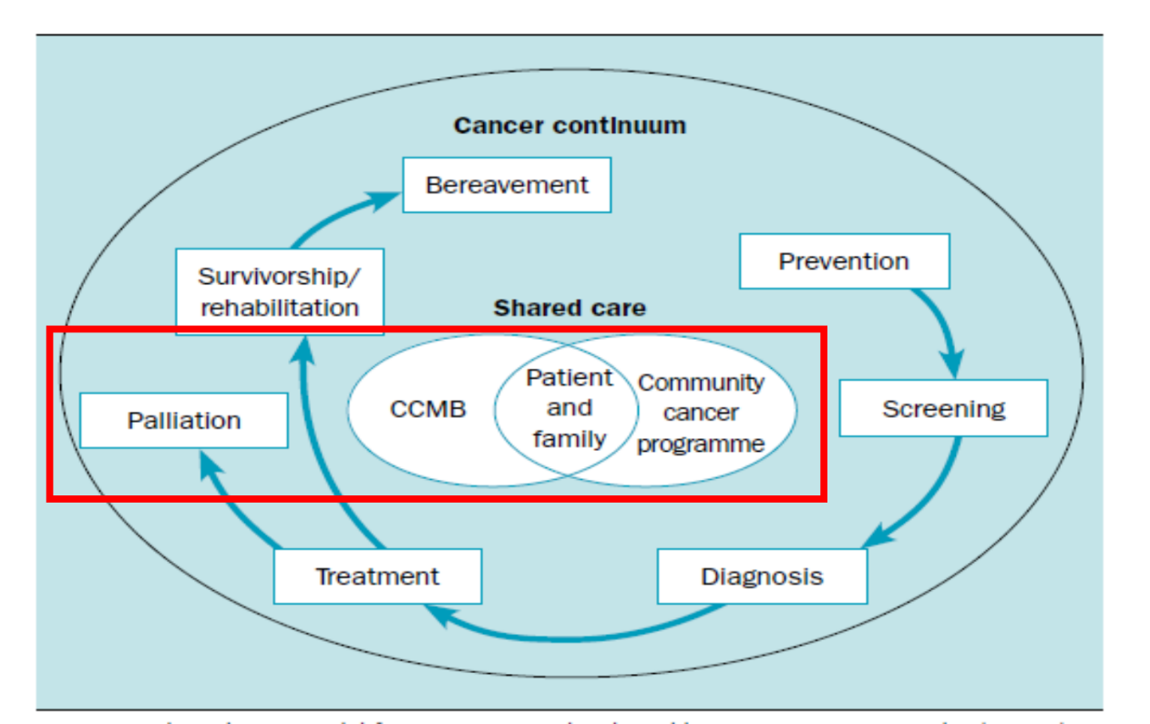
SmartConnect Areas in the Cancer Continuum
Patient Care areas
Palliative Care
Symptom & Toxicity mgmt.
Psychosocial services

Slide 8
SmartConnect Project
Team

Slide 9
SmartConnect Multi-Site Pilot Objectives
Enable multi-site large scale pilots to demonstrate personalised, integrated and replicable digital solutions for managing care in a multi-disciplinary environment for Cancer Patients (15000+ patients & 3000+ professionals)
Ensuring secure, accurate and reliable data sharing across the care team professionals and patients, while improving the workflow, adoption and productivity of the clinical and social teams
Enable a steering committee of regional policy makers at every Pilot site along with clinical leaders to enable a sustainable business model for growth and scalability beyond the multi-site pilots
Measure and monitor critical KPIs on utilization, ratio of professionals to patients, quality of care and cost
Enable smart-phone based mobile applications to empower patients to find services, provide symptom feedback, request preferred services and respond surveys (PHQ9, SF-36, Palliative Care and Quality of life assessments)
Measure and report on Cost, Outcomes and financial viability on clinician utilization per patients.
Demonstrate privacy enabled workflows on accessing social data and information in IT supported environment for personalized care (EU data protection regulation).
Enable clinical processes and academic best practices from the partners for integrated and personalized care
Enable reliable and replicable business models for IT supported solutions in a truly personalized and multi-disciplinary environment.

Slide 10






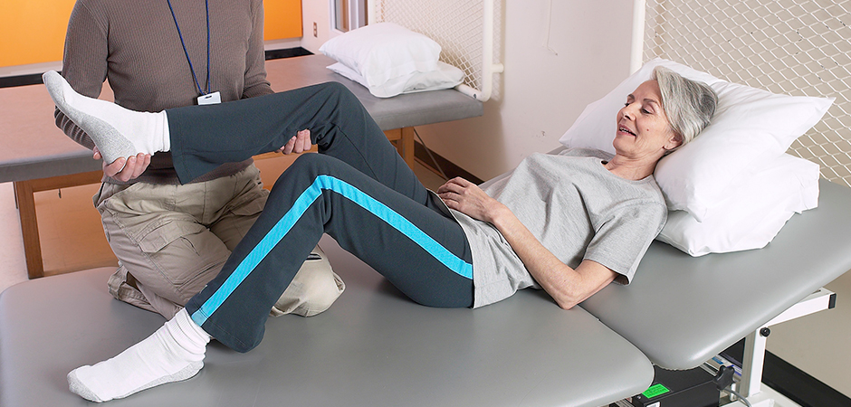

Consortium
Technical Coordinator
Technical University
Academic Center
Privacy Workflows
Coordinator and IoT Systems Integration
Cancer Center
Private
Duty Nurse
Specialist
Regional EU
Policy Makers
EU
GDPR
GP
Cancer Center
Patients
All Palliative
Care Group (Ireland)
GDPR & Policy
GP
Home Aide
Therapist
Oncoavanze
(Cancer Clinic)
Cancer Registries
Mobile Apps for Patients
(Patient engagement)
Platform & Population Health Lead (Clinical Process Lead)
ANT Foundation-
EUBIOSIA: Cancer Care@home (Palliative)

Slide 11
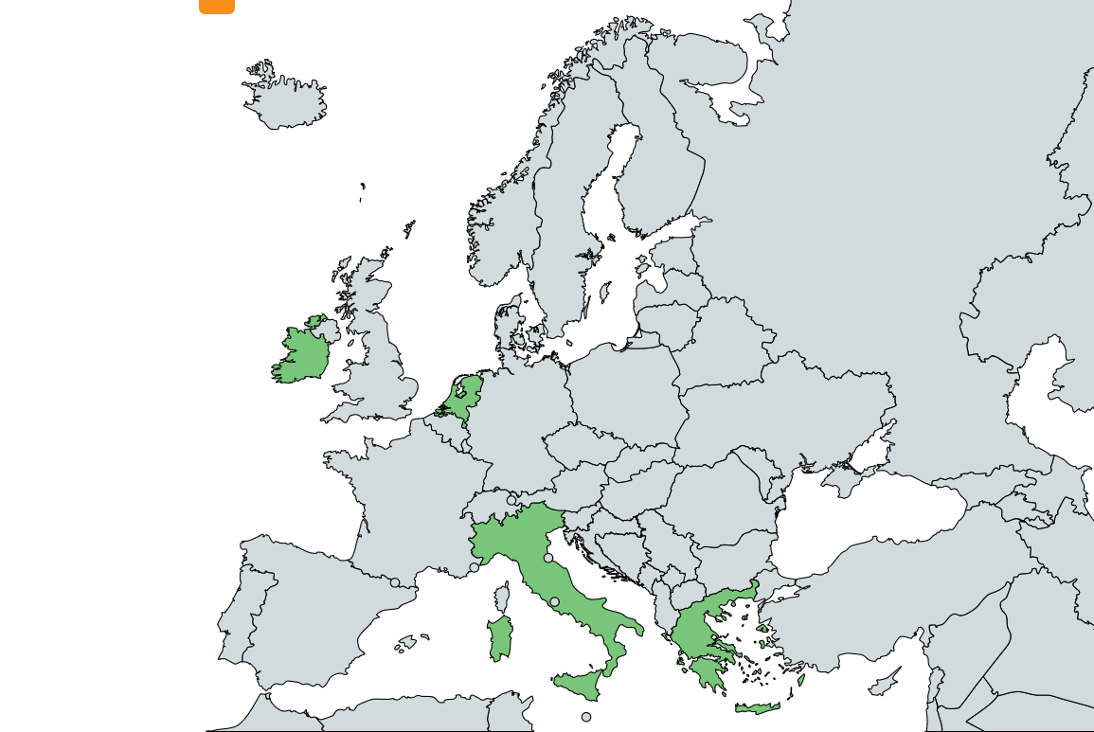





Pilot Sites Offering Care Services: Netherlands, Greece, Spain, Italy, UK and Ireland
Finland
All Ireland
Palliative
Ireland
Nutrition
Netherlands
Nutrition
Nutrition
Nutrition
Cancer Care
At-home
Spain
Italy
Greece
Greece

Slide 12
Pilot Site Size, Value Based Care Services & Digital Platform Needs
Multi-Site Pilots for Integrated and Personalised Cancer Care
PILOT Sites | Size |  | Stages |  | Integrated Network (Professionals) |  |  |  |  |  |  | Regional-Community Policy |  |  |  |  | Digital Platform & Solution
Region | No. Patients | No. Professionals | Curative | Palliative | Oncologists | Case Mgr | Palliative Nurse | GPs (General Practitioner) | Psychologists | Nutritionists | Social Workers | Public Health | Regional Health Mgmt | Cancer Registry | NGO | Home Health | Patient-Engagement-Tools | Digital Platform | PALL-SI, C, SF36, PHQ9 | Clinician Decision Tools
Greece | 600-1000 | 20-50 |  | Y | Y | Y | Y | Y | Y | Y | Y |  |  |  |  | Y | Y | Y | Y | Y
Netherlands | 100-200 | 50-100 |  | Y | Y | Y | Y | Y | Y | Y | Y |  |  | Y |  | Y | Y | Y | Y | Y
Ireland | 400-600 | 50-100 | Y | Y | Y | Y | Y | Y | Y | Y | Y |  |  |  |  | Y | Y | Y | Y | Y
UK – NHS | 5000+ | 1000 |  | Y | Y | Y | Y | Y | Y | Y | Y |  |  |  |  | Y | Y | Y | Y | Y
Spain | 800-2000 | 50-100 | Y | Y | Y | Y | Y | Y | Y | Y | Y |  |  |  |  | Y | Y | Y | Y | Y
Italy | 8000-10000? | 300-400 | Y | Y | Y | Y | Y | Y | Y | Y | Y |  |  |  |  | Y | Y | Y | Y | Y
Ireland-Hospice | 500-1000 | 50-100 |  | Y | Y | Y | Y | Y | Y | Y | Y |  |  |  |  | Y | Y | Y | Y | Y

Slide 13
KPIs/Measures for Pilot Sites on Integration and Outcomes
KPIs/Measures for Pilots on Integrated and Personalised Cancer Care
PILOT SITE | Size |  | Stages |  | Professionals – Adoption Measures |  |  |  |  |  |  | Quality of Care/Outcomes |  |  |  |  | Utilization/Cost Outcomes
Region | No. Patients | No. Professionals | Curative | Palliative | Ratio of Professionals to Patients | Professionals onboard in the region | Social care Professionals per patient | GPs - ratio per patient | Community Care Staff per patient | Nutritionists per patient | Social Workers per patient | Pain Medications (Opioids) | Chemotherapy in last 30 days | Ambulation Index | Falls risk | QoL index | ER visit rate | Hospitalizations | Length of Stay | Cost Per Episode/patient
Greece | 600-1000 | 20-50 | Y | Y | 8.33% |  |  |  |  |  |  |  |  |  |  |  | Y | Y | Y | Y
Netherlands | 100-200 | 50-100 |  | Y | 15.00% |  |  |  |  |  |  |  |  |  |  |  | Y | Y | Y | Y
Ireland | 400-600 | 50-100 | Y | Y | 6.67% |  |  |  |  |  |  |  |  |  |  |  | Y | Y | Y | Y
UK – NHS | 5000+ | 1000
Spain | 800-2000 | 50-100
Italy | 8000-10000? | 300-400
Ireland-Hospice | 500-1000 | 50-100
Greece | 600-1000 | 20-50

Slide 14
Partners: Clinical System and Guidelines
Clinical Providers (Cancer Clinics, Hospitals and Care Groups) | Role | Expected Workpackages
Erasmus Hospital, Netherlands | Cancer Care - Innovation in Palliative care
University Hospital, Crete | Cancer Care –Innovation in Palliative care
NHS, UK | Palliative care and Surgery division
Cancer Hospital in Central Europe* | Cancer Care – Palliative Care innovation scenarios
Cancer Hospital, Seville, Spain | Cancer Care - Palliative, Symptom Management and Wellness - Broad
Palliative care (all Ireland) | Palliative care group - Ireland
EUBIOSIA (B3 Good Practice), Italy | Cancer Care at home across all Italy
Clinical Processes and Decision-Making | Role | Expected value
CapsicoHealthCare, Ltd, Ireland | Clinical process domain, workflow ( clinical workflows, data and dashboards) Clinical Workflow leader.
Movendos, Finland | Mobile surveys, digital Health intake from patient homes (e.g. wearables) and video chat
UVT, JADs, Netherlands | GDPR, Policy, Process and Technology
Care Groups and All Clinics involved | Guidelines and policy

Slide 15
Partners: Technology, Apps and Hosting
Technology Partners | Role | Expected Workpackages
Engineering SPA | Lead in Innovative Technology Assets/Platform for Integrated Care
Movendos, Finland | Mobile Apps and Home device integration
ATC, Greece | Coordinator, Technology services and implementation
CapsicoHealthCare, Ltd | Data platform, data warehousing, Clinical decision making, outcomes dashboards and care management
UVT/JADS, Netherlands | Security, Privacy and related EU driven policy implementations
Tampere University (TU) | Mobile applications and outcomes dashboards
Politecnico Di Milano | Workflows, Microservices and Privacy models
Secure/Trusted Cloud Providers | Role | Expected value
Webair (Amsterdam) | Cloud vendor – GDPR & Privacy enabled

Slide 16
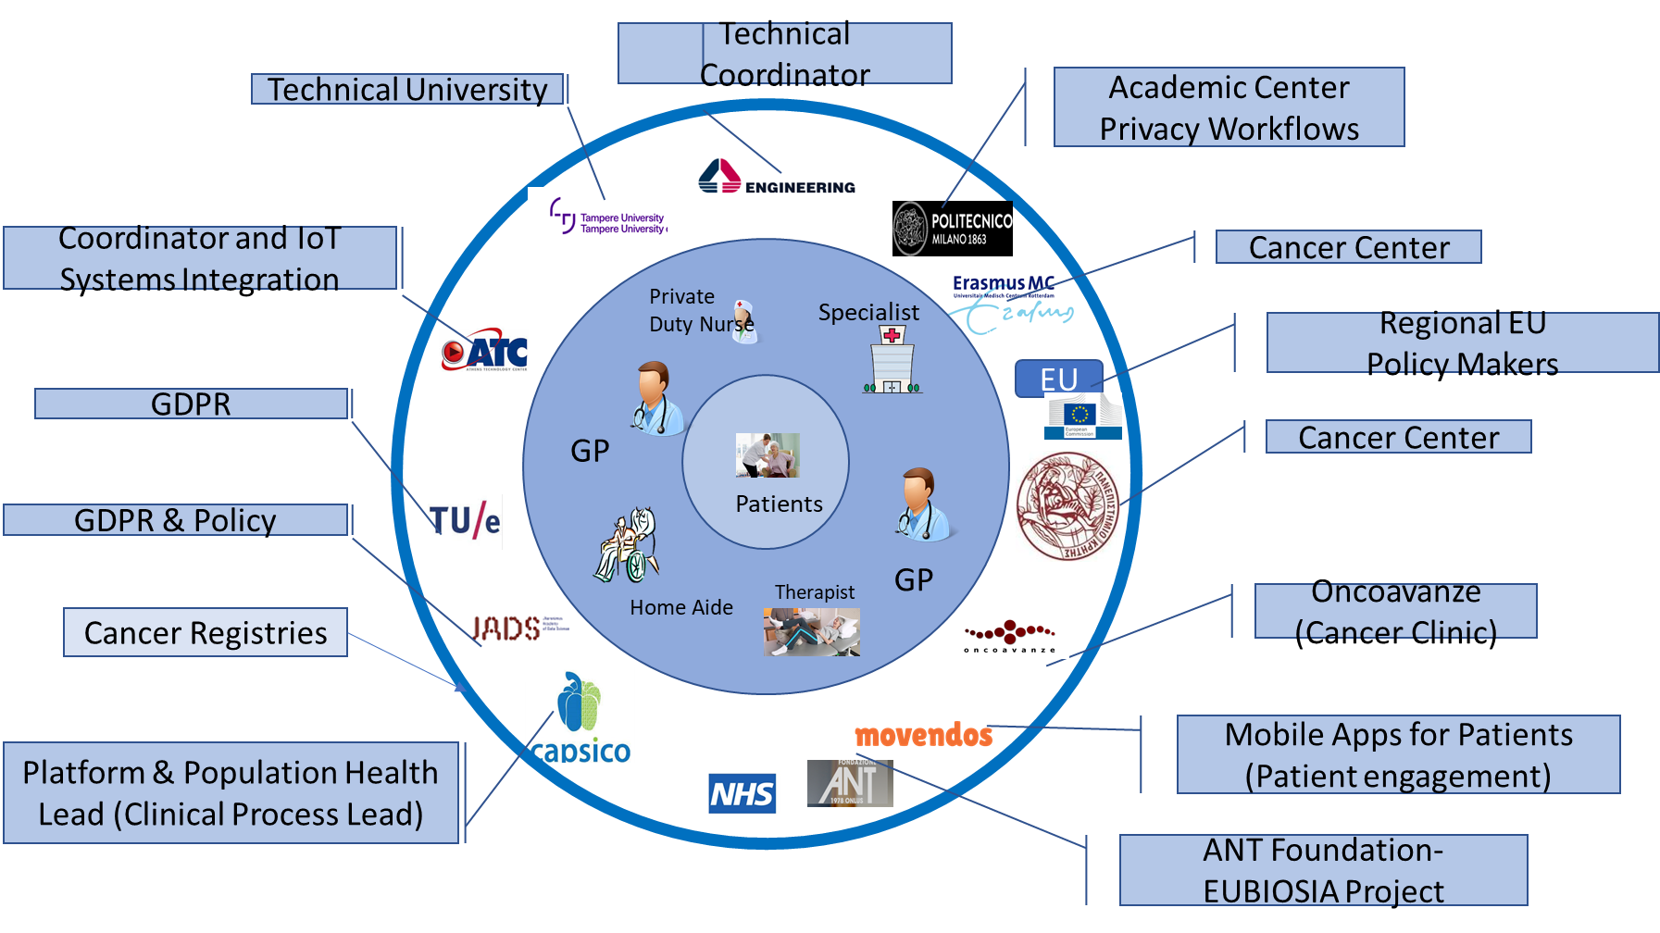
Integrated & Personalized Care Capabilities
Cancer Centers & Hospitals
Define care protocols
Patient consent for care
Patient enrollment
Professionals enrollment
Home care integration
Regional network integration
Pain, QoL & nutritional services
Observational trial
Patient adoption of technology
Outcomes/clinical measures
Technology and Clinical Workflow
Define care workflows
Software to enroll patients
GDPR support
Secure patient communication
Mobile apps for feedback
Low cost smart phone apps
Pilot trial management
Data warehouse
Dashboards on Outcomes
Regional and EU Policy Makers on Sustainability and Scalability

Slide 17
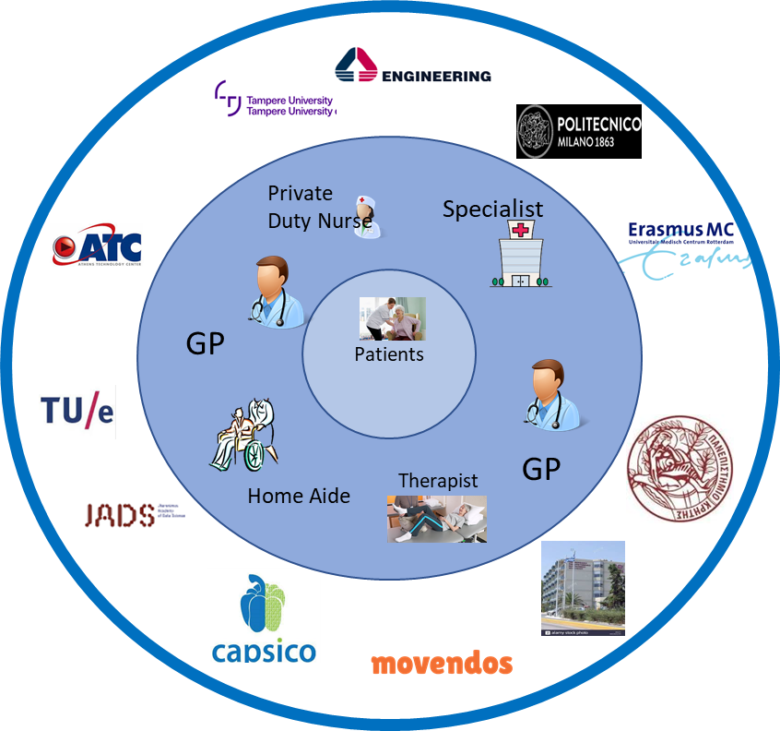
How do we manage Scalability and Long Term Sustainability? Regional & EU Network Representatives in Steering Committee for SmartConnect H2020
Community
Care (City and Regions)
Country/Regional Policy Makers &
Ministries/Agencies
EU
Integrated Networks
Awareness
Strategy
B3
Policy &
Sustainability Models
Policy &
Sustainability Models
Primary
Care, GPs
Physician
Network
(Regional)
Hospital
Network
(Regional)
Regional Model
Oncology
Team
Patient
Centric-Integrated Cancer Care
Professionals
Professionals
Home Health Aides, Private Duty Nurses
Nutritionists &
Skilled nursing
SmartConnect
Steering Group for
Policy makers

Slide 18
Multi-Site Pilot Deployment and Observational Design
SmartConnect

Slide 19
Multi-Site Pilot Deployment & Observational Design
Characteristics | Learning cohort | Validation cohort
Gender: M/F | M/F | M/F
N = 10000 patients (across 4 providers and Cancer Centers in Europe) | 7000+ patients across the hospitals and cancer centers | 3000+ patients (p< 0.01)
Disease areas: Stages 3 and Stage 4 Cancer Populations | Stages 3 and Stage 4 Cancer Populations | Stages 3 and Stage 4 Cancer Populations
Patient groups: All Cancer Types Ages: 60-110 | 60-110 | 60-110
Outcome variables: Symptom severity Hospitalization Urgent care visit Emergency room visit Infection (due to surgical procedure) | Symptom severity Hospitalization Urgent care visit Emergency room visit Infection (due to surgical procedure) | Symptom severity Hospitalization Urgent care visit Emergency room visit Infection (due to surgical procedure)
Hospital, Home Health factors Past hospitalizations Past urgent care visits Past readmissions Uncontrolled symptoms (e.g. nausea, vomiting, pain, headache, diarrhea) Stage of Cancer condition (Stages III & IV) Metastatic condition Past ER admissions Total LoS > 3 over the last 2 weeks Admission from hospice > 1 hospital visit OR > 1 ER visit De-identified Provider notes of the patient chart Symptom information in notes | Hospital and Cancer Center Hospital specific data on procedures and patient demographics Provider notes | Hospital and Cancer Center Hospital specific data on procedures and patient demographics Provider notes

Slide 20
Decision Support and Data Collection (EMR, PROMs, etc)
Data Sources | Provided by | Type | Key Attributes | Years
Hospital or Cancer Center provided deidentified patient charts | Hospitals and Cancer Centers in Europe participating in this H2020 proposal | Hospital reported performance measures | Type of cancer Stage of cancer Treatment types Modality Mortality Rates Satisfaction scores Infection rates | 2016-Current
Tobacco use surveys | Hospitals or cancer centers | Patient surveys | Satisfaction scores | 2016-Current
PHQ9 or PHQ2j (depression scale) | Hospitals or cancer centers | Depression scale and surveys | Depression scale | 2016-Current
Pain scale assessments | Hospitals or cancer centers | Pain scale surveys and assessment | Pain scale and ratings | 2016-Current
Quality of life assessments (e.g. SF36) | Hospitals or cancer centers | General quality of life based questionnaires | SF36 | 2016-Current
5000-10000 de-identified Patient records for the Pilot deployments to ensure low P value and statistically significant measures | Hospital providers in the Netherlands, Greece and UK | Clinical Charts (physical or electronic) | Visits Age Los Past visits Severity of illness Symptoms | 2016-Current

Slide 21

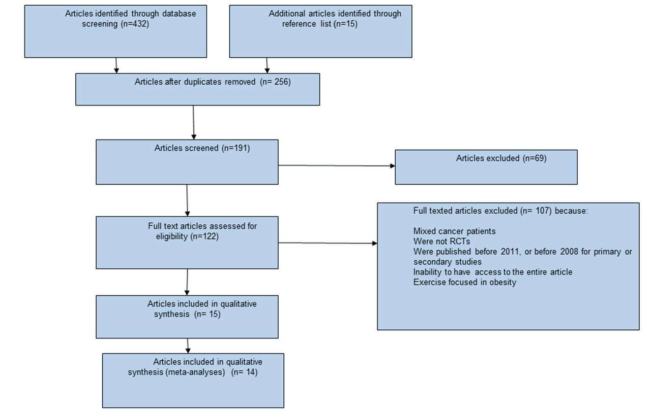
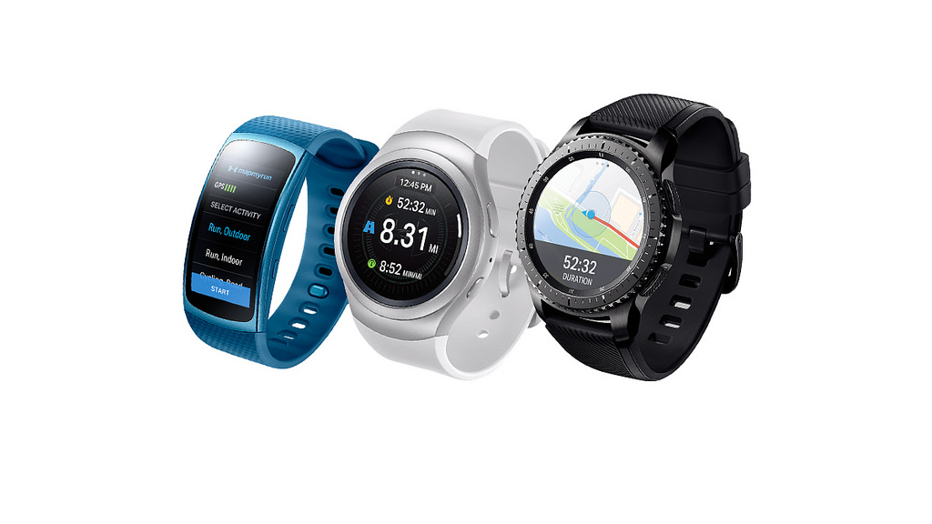
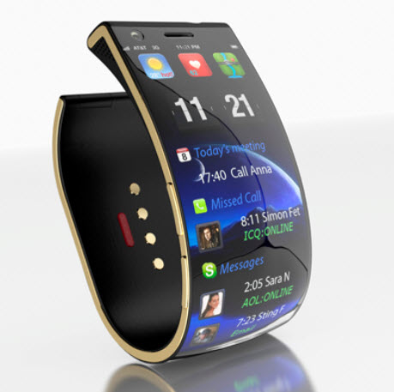




Multi-Site Pilot System To Integrate & Personalize Care
A comprehensive view of
processes between acute
and home based care
Total cost of care and clinical
outcomes monitoring for at-risk populations
Wearables
Guidelines
Private
Duty Nurse
Specialist
Wearables
Patients
Smart
Phone
GP
GP
Home Aide
Therapist
Smart
Calendaring
Inclusion of large number of professionals for social, nutritional
and pain management
A multi-level care: regional and community wide approach
to enable integration and
Personalization
Weight scale

Slide 22
Workpackages & Structure: 7 work packages
Pilot System: Data Integration, IT and Apps
Pilot and Clinical Specs and Criteria
WP 3: Pilot
Assets
(GDPR,
PE,
Platform)
WP 1.2: Pilot
Clinical
Guidelines
WP 2 Pilot Site setup spec, data Integration, test & process flow
WP 1.1 Pilot – Specifications, Planning &
Good practices enrollment (patients & professionals)
WP 5
Live Pilot Deployment for Integrated Care
(Digital Solution
Operations)
WP 4: Smart Phone Apps
Patient Engagement
WP 6.1 Pilot Outcomes & Progress Dashboards
WP 6.2 Patient QoL Outcomes
WP 7: Dissemination
& Steering Group
WP 8: Project Management

Slide 23
WP Flows
Year 1
Year 2
Year 3
Year 4: 6 months
WP1: Pilot
Req/Specs/Good-Practices & Enrollment
(Patients/Professionals)
WP2: Pilot Site Set up, early Integration to EMR, test and validation flows (12 months)
WP3: Pilot Assets, GDPR (10 months)
WP4: Smart Phone App Set up (8 months)
WP5: Pilot Deployment for Integrated Care (EMR Integrated)
Decision tools for professionals and Apps for Patients
WP6: Pilot Outcomes, patient QoL and Dashboards (30 months)
WP7: Dissemination and Scalability Steering Group (30 months)
WP 8 Project Management (42 months)

Slide 24
Pilot Process Flow
1. Pilot requirements and specification for enrolling Patients & professionals
2. Multi site Pilot set up, data integration, test and workfows
3. Pilot Assets, GDPR and Security set up
4. Pilot Mobile Application deployment & integration
5. Pilot Deployment and Operations
6. Pilot outcomes, measures and patient QoL dashboards
7. Multi-site pilot learnings and governance
Multi-Site
Pilots for Integrated
Care

Slide 25
Integrated Digital Platform and Clinical Decision Tools for Professionals. Patient Engagement Mobile Apps for Empowerment and Decision-making
SmartConnect

Slide 26
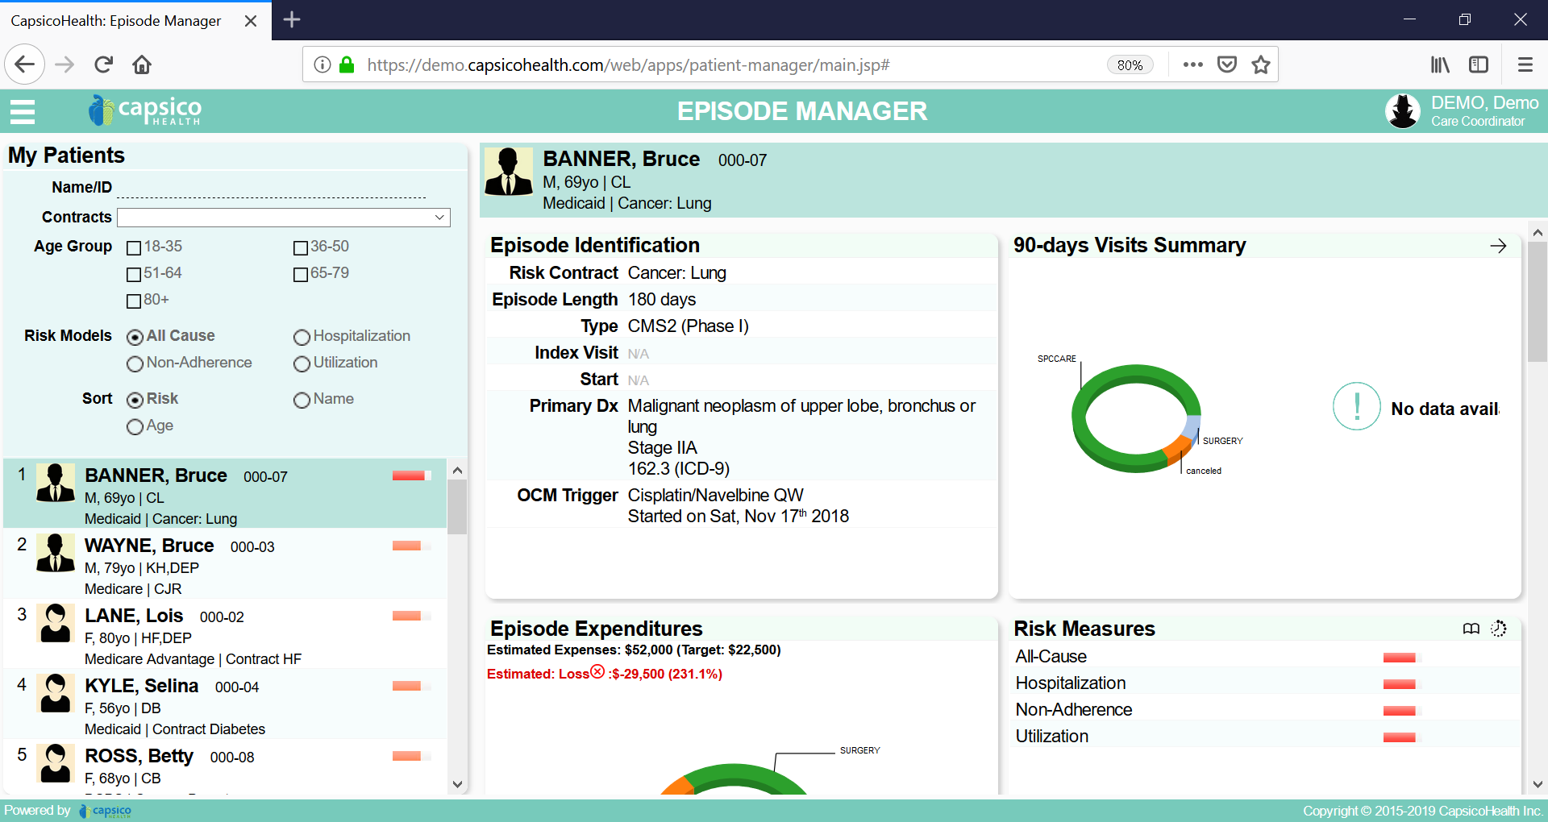

Clinical Decision Tools To Clinicians for Cancer Care
Decision Making - Identification
Candidates for Early Palliative Care
Candidates for Advanced Care
Candidates in need of social support
Candidates for nutritional support
Daily Patient List Panel
Risk Stratification Areas

Slide 27
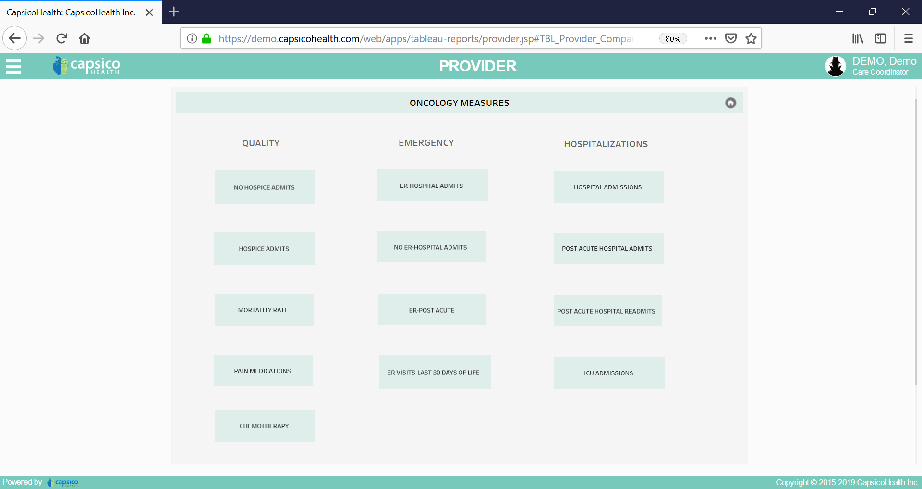
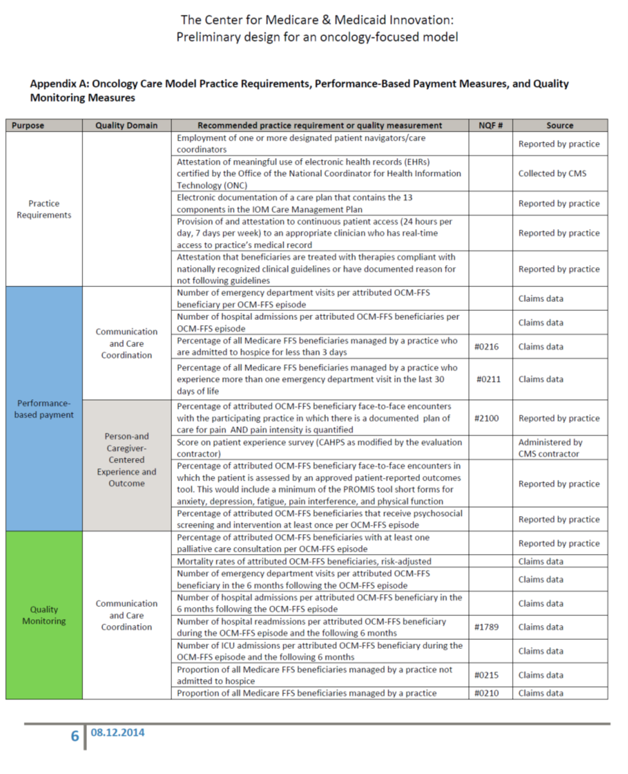
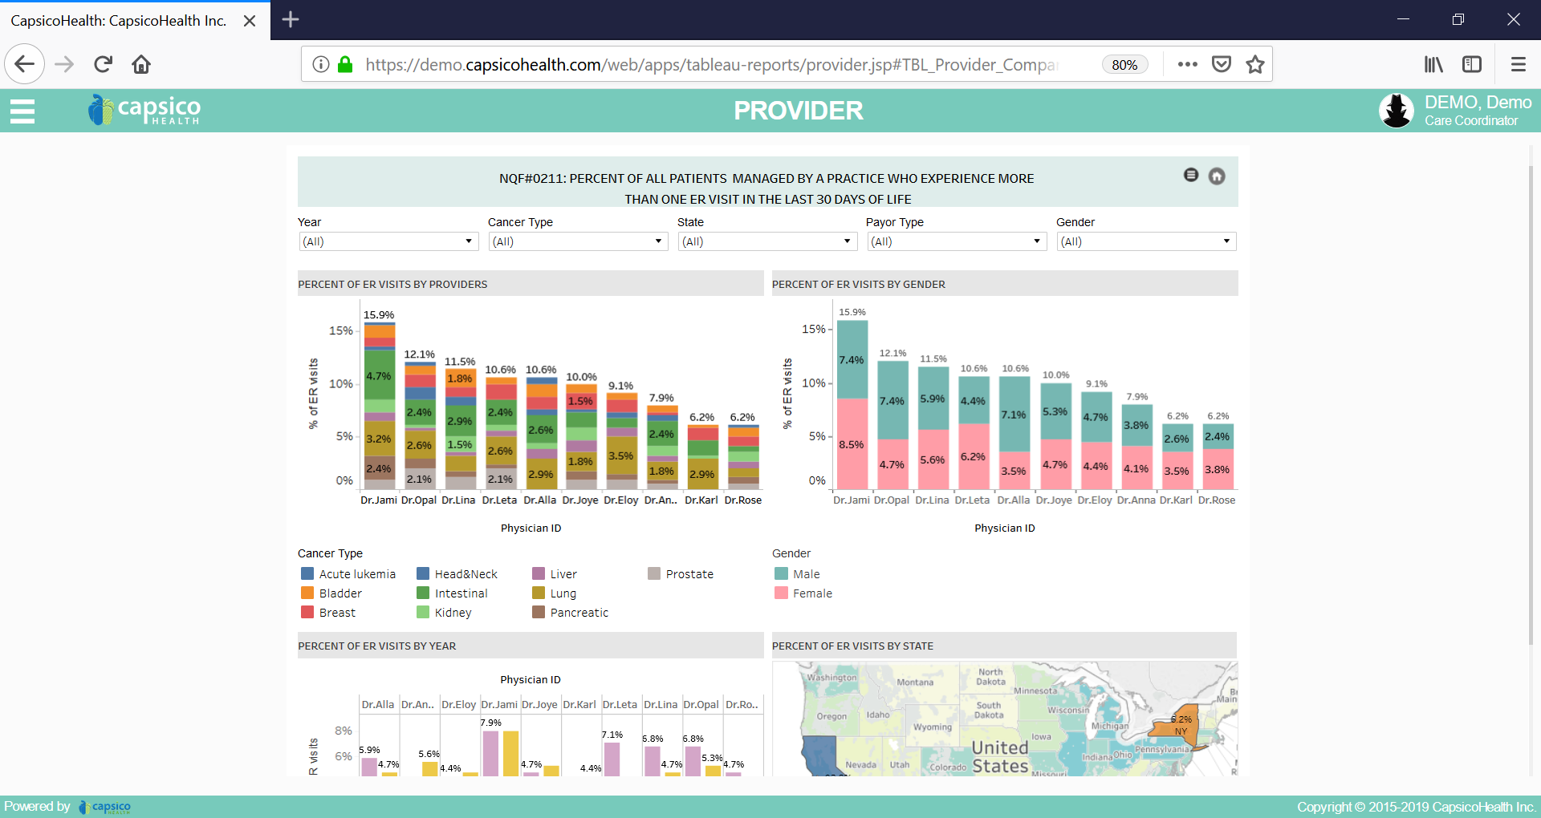
Standardized Outcome Measures Across Multi-Site Pilots
Clinical Outcomes
Utilization
Quality

Slide 28
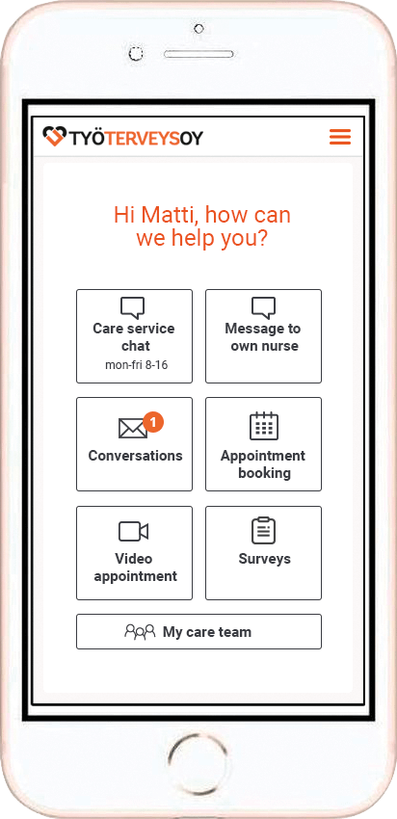

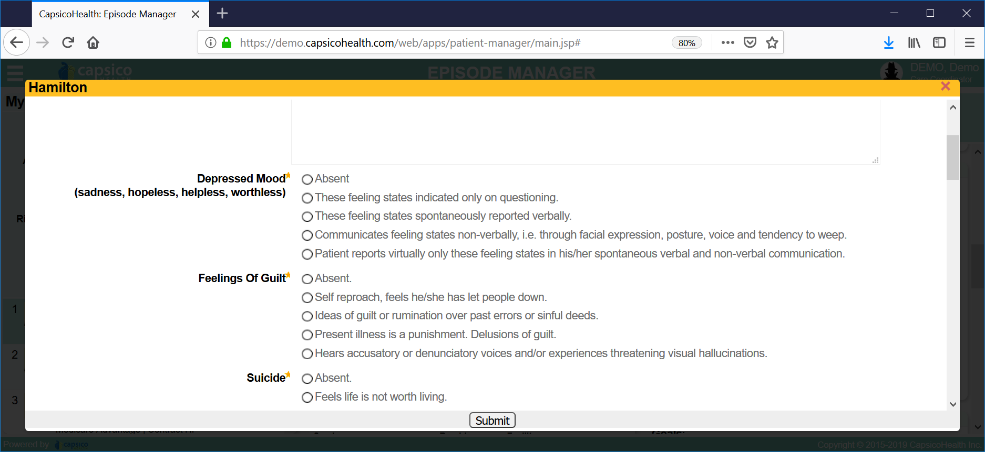

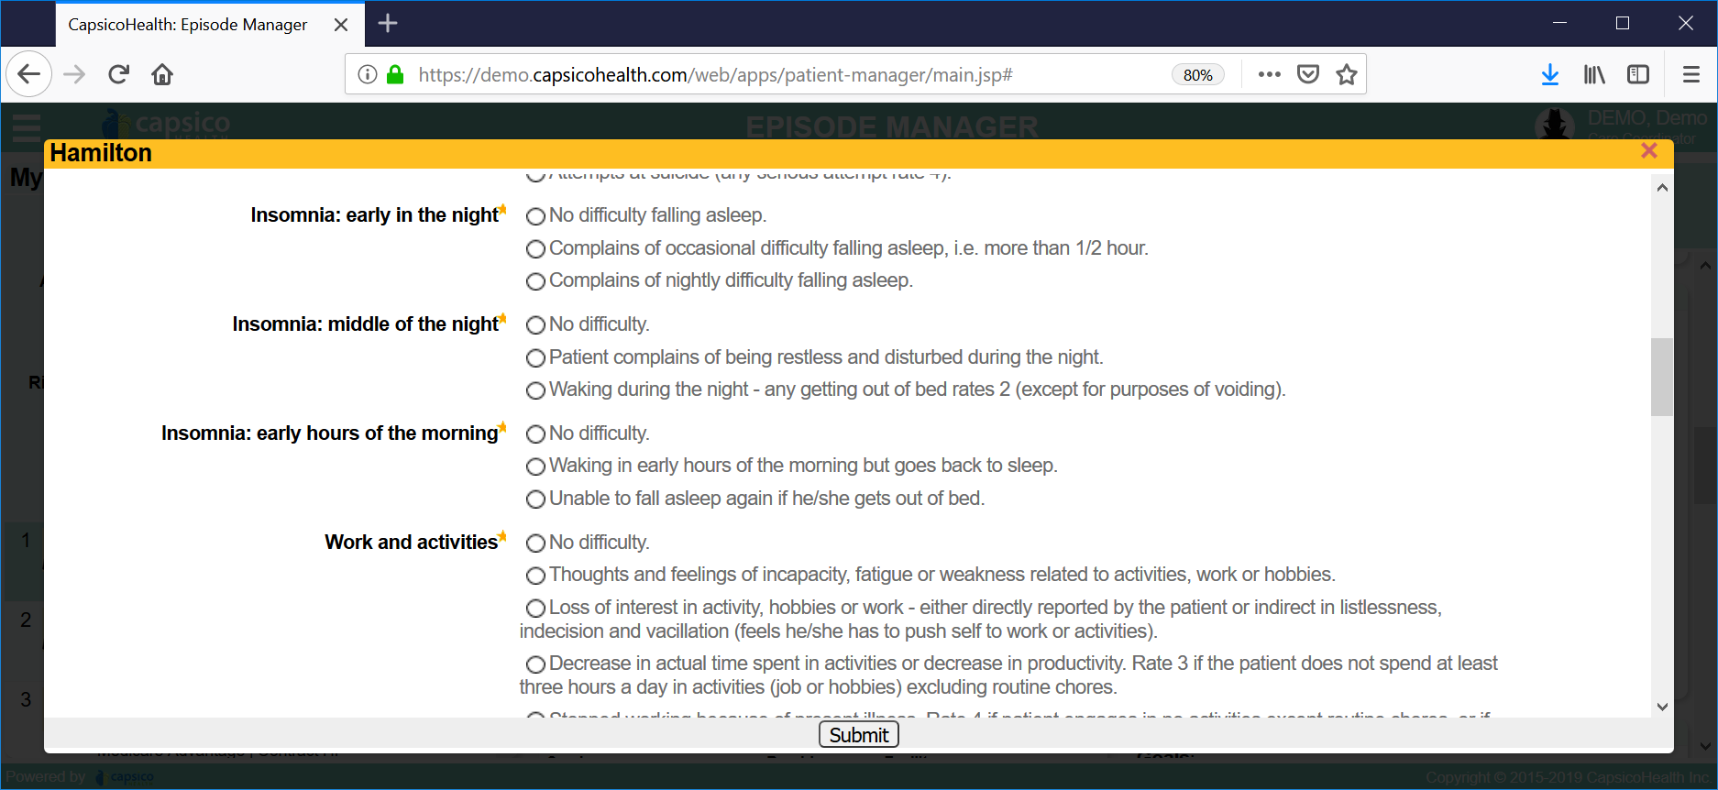
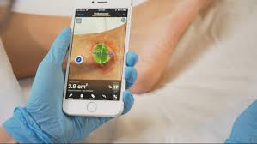
Patient Engagement Tools: Smart Phone Based
Clinician
View
Patient
Smart Phone
Apps
Patient feedback
Patient Surveys
Digital Wound
Summary

Slide 29
Work Package Summaries
SmartConnect

Slide 30
Workpackage Summary
Workpackages | Description | Months | Who is involved?
WP1 | Patient care criteria (EU specific guidelines) and clinical processes for care management for Cancer patients – palliative care |  | Healthcare providers (e.g. hospitals and cancer centers)
WP2 | Digital platform to help clinicians to identify and enroll, and patients to report on symptoms and need – Data system, enrollment processes, tracking, and outcomes. Cloud enabled |  | Healthcare providers and IT system companies
WP3 | Identification and decision-making for patients for Palliative or psychosocial support (and care). Risk analyses methods to rank the patients |  | Hospital and Cancer Centers
WP4 | IT system trust and security protocols to ensure patient privacy when using the mobile application (GDPR). |  | Healthcare companies providing technology to the project using open GDPR technologies
WP5 | Patient reported data and feedback using a smart phone application. The app alos enables simple surveys (e.g. SF36, pain assessment, psychosocial assessment) |  | Healthcare companies providing technology for patients
WP6 | Clinical processes and criteria for patient identification, enrollment and care during and after treatment (e.g. palliative care) – Hospital specific guidelines and governance |  | Hospital and Cancer Centers
WP7 | Dissemination of the clinical processes, measures, technology driven application and outcomes monitoring |  | Hospital and Cancer Centers, and Healthcare companies
WP8 | Reporting and dashboards for outcomes and patient care performance. Reporting to include key measures such as pain medications, therapy outcomes, sideeffects of therapy, infections due to surgery and chemotherapy during the few weeks of end-of-life care |  | Hospital and Cancer Centers, Healthcare IT companies
WP9 | Project management across the project and across all Pilots. Individual Pilots managed by local hospital centers with coordination from the project coordinator |  | Overall project coordinator
WP10 | Steering Committee - to impact policy and sustainability, and integration best practices to service providers, community and policy makers |  | Policy Makers – regional – 3 to 4 regions and hospital networks

Slide 31
Pilot System and Clinical Scenarios: Patient Medical Record Review, Enrollment, Care Services and Monitoring
Team

Slide 32





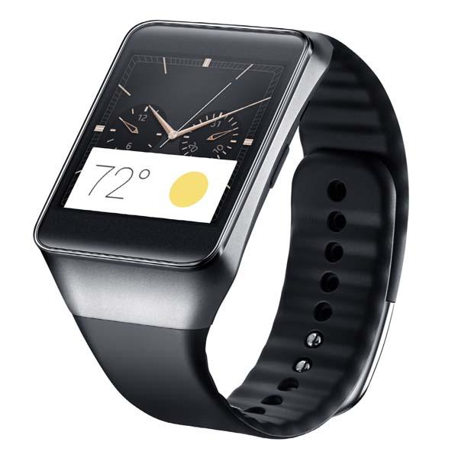



Pilot System Architecture for Each Region
Identification & Risk
Professional
Network
Care
Management
Pilot (s)
Outcomes
Patient
Apps
Clinical Process Flow
Criteria/Rules
GDPR
Workflow Engine
Analytics Services
PRD Services
Clinical
Guidelines
Data Warehouse
Data Quality
Outcomes Data Marts
FHIR
Secure Data Platform (Capsico)
Medical
Records
Registry
(Pilots)
PRD
Geo
location
Wearables
Surveys
(PH36)

Slide 33
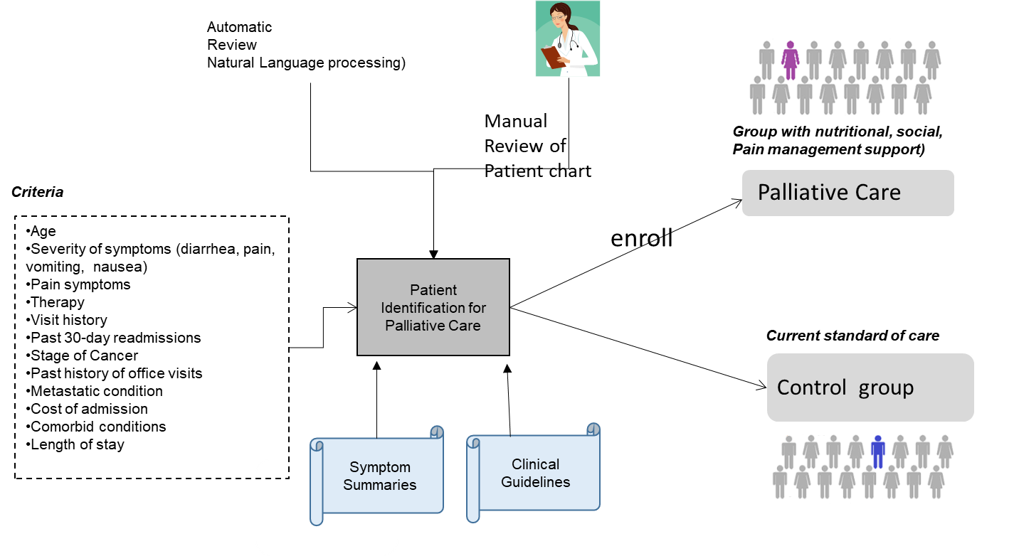
Process Scenario 1: Enrollment to Control & Observational Groups
Each Pilot
Site will
suggest their
Preferred
criteria for
Patient
identification

Slide 34


Process Scenario 2: Register Providers and Professionals (Scaling through Technology)
(Pilot System) to Register
Hospitals, GPs, Home Health and
Other Certified
External
Providers
Register Hospital Clinical Team
5
Invite External GPs
1
Access
Hospital
Case manager
Hospital GP
Palliative nurse
Clinical nurse
Social worker
6
Invite Home Health Nurse
Pilot
System
Administrator
2
Review capability to
Enroll patients. Set roles
And GDPR policies
7
Social
Worker
Invite Social Workers (External)
3
8
Nutritionist
Set up userids/passwords
Invite/Schedule nutritionist (External)
Home Health
Aide or
Therapist
Send Invitations to
GPs, HHA, etc.
GDPR
Policies
9
Invite/Schedule home health aide
4

Slide 35



Process Scenario 3: Clinician Workflow to Review &Enroll Patients for Palliative Care. Provide Support to Enrolled Patients
Pilot &
System to Enroll Patient and schedule services
Patient notified
On goals
1
Review patient criteria
Before discharge
3
Patient activates
Care-app
Uncontrolled Symptoms
Stage 3
Metastatic
Non-Small Cell Lung Cancer
History of admissions
Lack of support
Case Manager
Or Care
Coordinator
4
Schedule follow up
Wearables
(e.g.
weight
scales)
Patient meets criteria for closer follow-up through mobile care-app
2
5
Care Plan for
Patient
Schedule visits
Review patient progress & feedback

Slide 36
Patient Engagement Tools and Workflow: Mobile Apps to Enable Symptom Feedback, Digital Wound Status, Video Visits, Connectivity, and Empowerment
Team

Slide 37

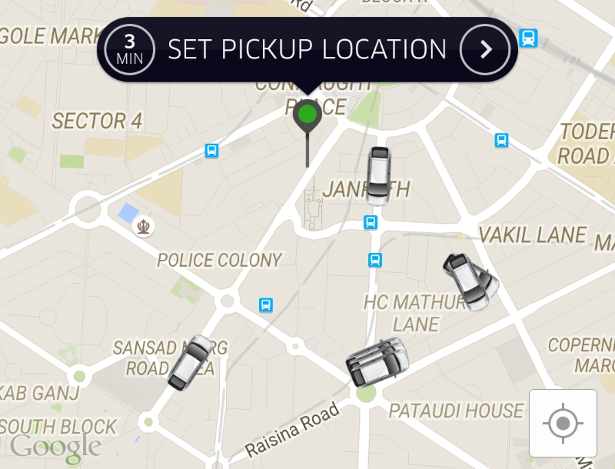
Process Scenario 4: Services to Enable Patients to Access to Pain Management Services
Trusted
(GDPR based)
Access
App & System To Find & Schedule Services with
Private Duty providers and nutritionists
RN matched to
Patient (Notify RN)
1
Search for all private duty services (zip code)
4
5
2
Show me my patient
Summary/profile/risk
Show me recommended providers for pain management
Private Duty
Nurse
Patient
3
6
Schedule service visits
Show my schedule of
visits to patient’s home
Show me my upcoming visits
7

Slide 38
Process Scenario 5: Mobile App to Enable Patients to Access GP
Trusted
(GDPR based)
Access
App & System to Find & Schedule Services
With
GP
Notify GP
Access
1
Search for PCP information
4
5
Show me my patient
Summary
2
Find availability
GP
Patient
3
6
Schedule visits
Show my schedule of upcoming patient visits
Show me my upcoming visits
7

Slide 39
Process Scenario 6: Mobile App To Help Patient Schedule Social Support & Therapy Services
Trusted
(GDPR based)
Access
App & System to Find & Schedule Services, and Post-Treatment Care
Notify Service Provider
1
Acces
Search for all private duty services
4
5
2
Show me my patient
Summary/profile/risk
Show me available
Private duty providers?
Support
Services or
Aide
Patient
3
6
Schedule service visits
Show my schedule of
visits to patient’s home
Show me my upcoming visits
7

Slide 40
Summary of Large Scale Pilot Areas
Integrated Care
Integrated network of providers on ONE Digital platform to see patient information
Integrating over 10000 patients and 5000 professionals
Population health tools to clinical providers (GPs included)
Integration of regional public health and policy makers
Patient Engagement (Personalised services and empowerment)
Patient focus groups/survey on use of technology to report symptoms
Patient enrollment over 24 month period
Processes to connect patients to support services
Process to add smart phone services for the patient with their hospital/provider group and any certified home health agency or social support
One Digital Platform to bring professionals and patients
Process to integrate professionals and patients (and their medical records)
Digital platform to enable privacy models to ensure Pilots are operating independently (and sharing outcomes information)
Per patient monitoring of outcomes (with the smart phone and palliative services)
Outcomes
Patient outcomes dashboards (including cost and quality measurements)
Patient experience measures
Adoption ratios: Professionals integrated (vs number of patients and number of overall professionals in the region)
Utilization outcomes (e.g. ER visits, readmissions, admissions to hospitals, length of stay, etc.)
Services provided towards end of life

